Slide 1
ADVANCED COMPUTING TECHNOLOGY Company Presentation

Slide 2
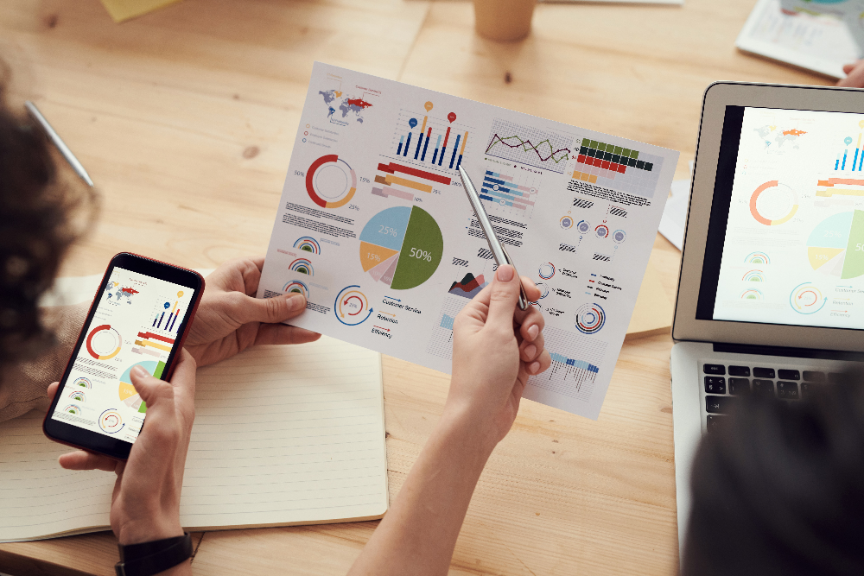
About us
We’re an IT consulting company with wide ranging ambitions, highly professional mindset and exceptional track record.
Our distinguished skills and unique expertise are in Master Data Management, data quality and costs optimization related topics, including processes, tools and compliance measurements and monitoring.
Our activities range from general IT consulting, solution providing, data quality and analytics, software development, project management to IT operations and support.
Our team consists of highly skilled personnel with accent on ownership mindset and constant improvement. Managed by Dr Vlado Milosevic who has over 30 years of industry experience in the topics we are covering.

Slide 3
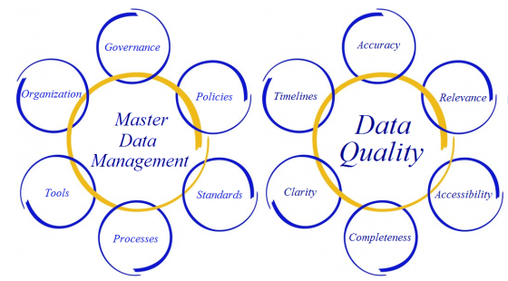
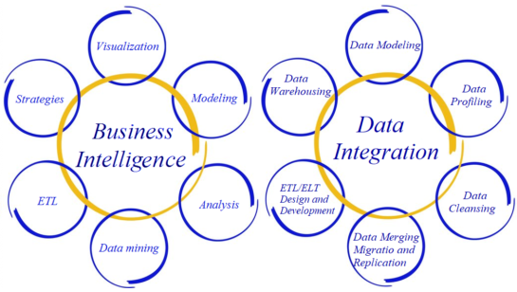
What We Do – Services, Solutions, Capabilities
MASTER DATA MANAGEMENT We have been performing activities ranging from consulting (i.e. identifying KPI), data integration (many different data sources) to application and UI development
DATA QUALITY Our huge experience in this field allows us to quickly understand and detect data quality deficiencies; and to create interactive dashboards that reduce costs of these exercises by automating/simplifying operational processes
BUSINESS INTELLIGENCE We are covering the entire process starting with integration with data sources, data preparation and historization, to visualization using both out-of-the-box and custom-made solution
DATA INTEGRATION Assisted integrations providing consulting services – helping understand content, helping detect important attributes based on customer needs Assisted integrations providing technical support

Slide 4
Technologies we are most familiar with
WEB BASED Application
.NET, ASP.NET (C#)
JSF, JSP, Servlets (JAVA)
JavaScript, php, python
Html, CSS
Windows application
.NET (c#) and Java platforms
.NET CORE, universal windows applications
C++
Mobile applications
android
DATABASE
Relational databases (SQL Server, MySQL, SQLite)
Ssis, ssas
Document based dbs (mongo db)
DATA VISUALISATION
Power bi
Qlik sense
Tableau
In-house developed asp.net visualization elements

Slide 5
Recent Projects & Activities

Slide 6
Recent Projects & Activities
Master Data Compliance Tool
Cross Directories Search Tool
IT Assets Management Tool
Footprint Tool
HR Master Data Connector
Directories Data Quality
IS/IT Control Platform
Travel Management Systems Interface to ASPs
Mandatory Legal & Integrity Compliance Interface to ASP
Data Quality Management (DQM) Talend based Tool
Applications Rationalization Program

Slide 7
Master Data Compliance Tool
Idea: measure Master Data compliance in multiple business functions (HR, IS, Finance, Core Business…);
Built, maintained and improved for over 10 years
Consists of over 30 sub-applications, each of those having separate data models to allow having clean-cut and focused measurements for each
Highly sophisticated integration layer that gives single-system experience
We have been performing activities ranging from consulting (i.e. identifying KPI), data integration (many different data sources) to application and UI development

Slide 8
Cross Directories Search Tool
Idea: have Single place to check employee data coming from Multiple systems
Built, maintained and improved for over 10 years
Highly complex data model in the background that integrates and cross-references employee data from multiple directories; includes data validation from perspectives of MasterData, between directories and between attributes
Allows browsing of data through multiple dimensions
Highly used tool with over 60.000 distinct users over a 12 month period; countless use cases
We have handled entire development and maintenance starting with identifying relevant data sources to identifying and developing updates on live system based on detected use cases

Slide 9
IT Assets Management Tool
Idea: have a tool that enables tracking the entire lifecycle of IT assets globally
System that integrates and cross-references asset data from multiple data sources; achieved great success with overcoming issues coming from low data quality
Strong emphasis on measuring asset status KPIs and achieved improvements
Our team has also been involved in operational tasks such as data quality improvement and assisting in work related to reaching KPI targets

Slide 10
Footprint Tool
Idea: have a high-level BI platform that gives clear overview of company structure through multiple relevant dimensions
Extremely important tool in supporting divestments and acquisitions; includes views for employee headcounts, IT infrastructure, locations etc.
Strong emphasis on high-quality, high-performance and easy to use UI since tool is used by upper-level management
Allows slicing of data through multiple dimensions
Contains historical data which allow users to:
Know exact company structure on a past date
Know period-to-period changes

Slide 11
HR Master Data Connector
Idea: create a universal integration point for HR Master Data
Serves over 60 consuming applications
Main challenges:
Create and maintain a high performance data model
Synchronization from company HR system – 100% correctness
Ensure and enforce data quality and data completeness standards required by consuming applications
Built an oData web service
Assisted integrations providing consulting services – helping understand content, helping detect important attributes based on customer needs
Assisted integrations providing technical support

Slide 12
Directories Data Quality
Task: ensure data quality (example – Active Directory, HR directory…)
Over 15 years of experience
Levels of support:
Consulting – acquiring deep understanding of data content in order to detect KPI; assist in process improvement
Operations – work on ensuring and improving data quality
Technical – create tools that automate processes
Our huge experience in this field allows us to quickly understand and detect data quality deficiencies; and to create interactive dashboards that reduce costs of these exercises by automating/simplifying operational processes

Slide 13
IS/IT Control Platform
Idea: have a tool that automates IS budgeting and controlling process
System digs deep into budgeting and controlling and automates all aspects, starting with bulk importing of low-level data, complex calculations, complete transparency over process, controller input, and full reporting
Includes several points of data validation (input-level, vs MasterData etc.)
Strong emphasis on User Access Control given the fact that the data is sensitive and there are very different types of users

Slide 14
Travel Management Systems Interface to ASPs
Task: HR Master Data integration with different kinds of Travel Management Systems – including HRG, Simeno, Concur, Traveldoo, CITS
We have successfully completed integrations with different kinds of Travel and Expense systems, and have experience with what is needed by these systems both from perspective of data format and data content
We have understanding of relations between HR data feeds for these systems and other feeds (Organization structure, Reporting structure..)
We have also been performing hypercare, regular and maintenance operations so we have experience working in mentioned tools

Slide 15
Mandatory Legal & Integrity Compliance Interface to ASP
Tasks: HR Master Data integration to learning platforms, cross-platform data migration (courses, employees…), Compliance-related tasks
Created dashboards for monitoring compliance; customizable automated email systems for issuing invitations and reminders for attending courses
Access monitoring due to data sensitivity (based of company HR data)
Defining KPIs, operational work on improving compliance, measuring improvements

Slide 16
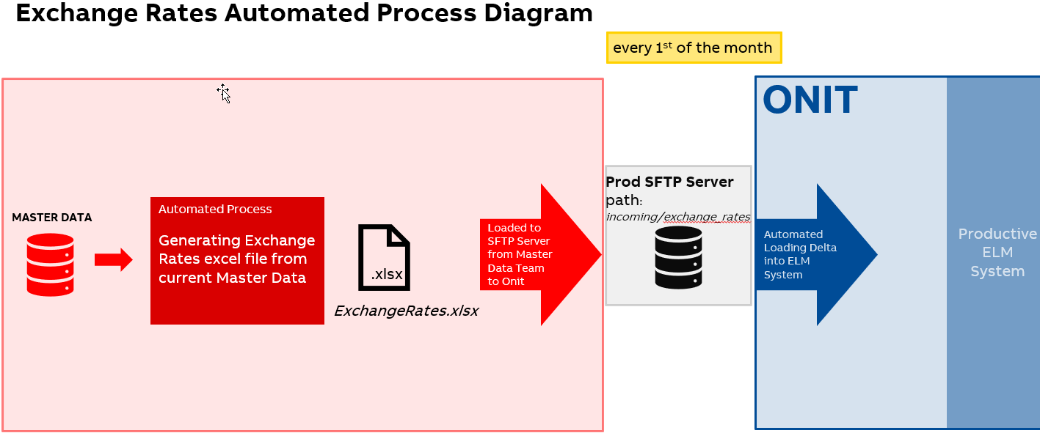
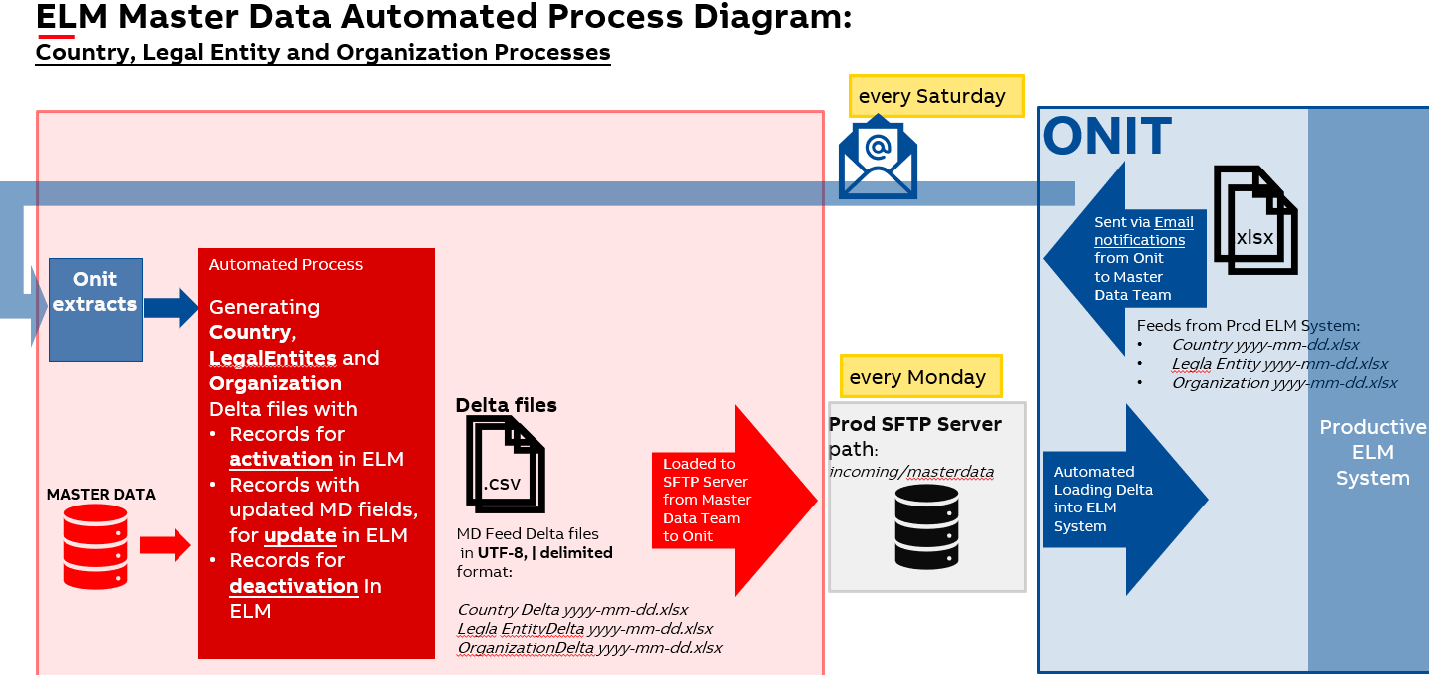
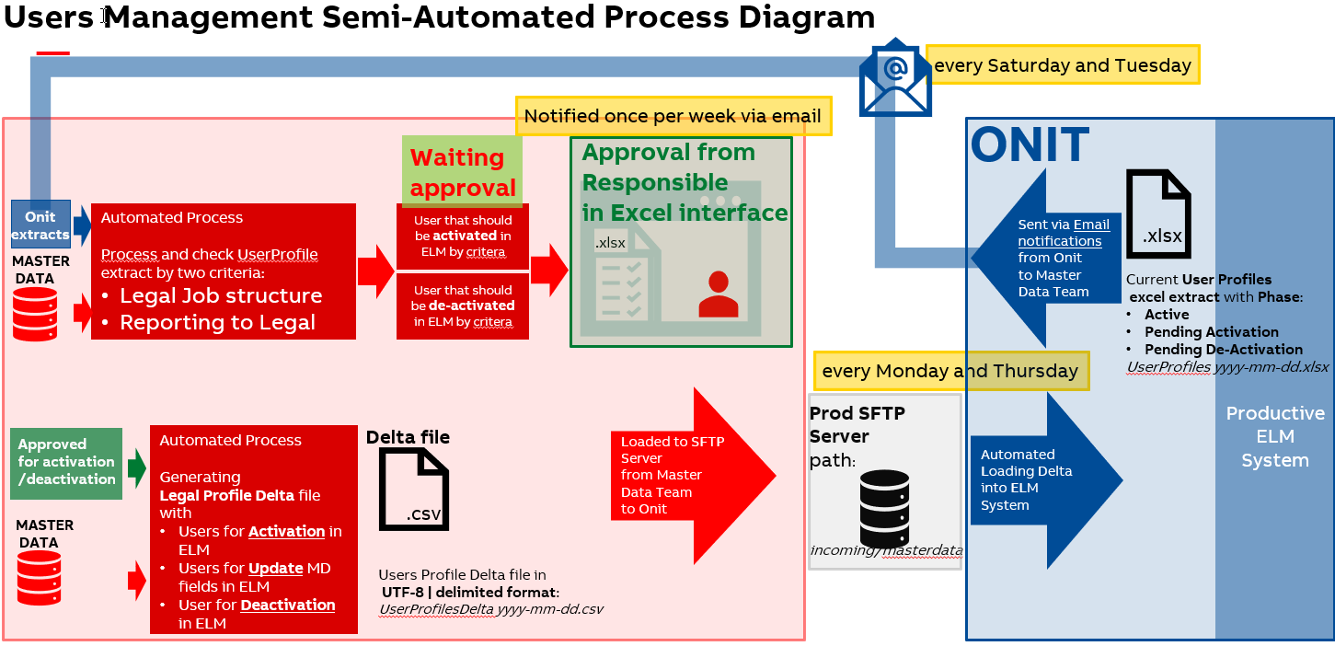
Automation of Master Data (MD) Feeds to the Onit ELM System
Tasks: As part of the initial ELM roll-out several Master Data Apps were created so that supporting data can be provided to the ELM System. These are:
User Profiles
Legal Entities
Countries
Organization
Exchange rates
Automized data load from MD was created
Automized comparison between extracts received from Onit via email notifications and MD; Delta files generated and provided to Onit ELM System via SFTP server on weekly bases
User Profiles semi automized process covering:
User Access Management tool developed in excel for responsible Employee in order to be able to grant/remove access to ELM Users and update their profiles
Automized data load from MD was created
Automized comparison between User extract received from Onit via email notifications and MD; Delta files generated and provided to Onit ELM System via SFTP server twice per week
Created dashboards for monitoring all processes

Slide 17
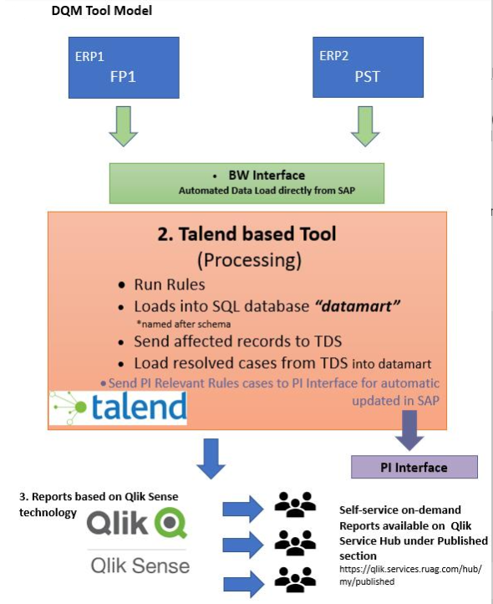
Data Quality Management (DQM) Talend based Tool
Task: create automated tool for managing general data quality and advance data preparation & cleansing for achieving minimum requirements for migration SAP R3 to SAP S4HANA; Talend environment chosen for DQM tool implementation based on customers requirements;
DQM Tool includes:
Automated Data Load from SAP via BW Interface
Fast and reliable running of relevant DQ Rules in Talend
Keeping affected and resolved records periodized in SQL Server
Sending affected records into Talend Data Stewardship (TDS) for checking by Data Stewards (also storing affected records into excel files)
Loading resolved cases from TDS
Sending PI Relevant Rules cases to PI Interface for automatic updated in SAP
Handling error cases from automatic SAP update
Levels of support:
Consulting – architectural level design
Operations – work on ensuring and improving data quality by performing monthly DQ Rules RUNs; implementing additional DQ Rules, which acquired deep understanding of data content; assist in process improvement;
Technical – completely create Talend tool that automate processes, connecting Talend tool and storing periodizes data in SQL Server and Qlik Sense Reporting for DQ Monitoring

Slide 18
Applications Rationalization Program
Idea: rationalization of used Applications, regarding number and costs related to it throughout different company domains
Complex structure analysis with defining potential cost saving, taking into account diversity of domains, business units, application use, level of usage, etc.
Team has taken-up tasks ranging from consulting – (i.e. defining KPIs) to operational (i.e. follow-up issues in order to maintain target levels for data quality)

